Slide 1
Nutritional Recommendations for the Physically Active Person

Slide 2
Objectives
Describe the basic principles of energy balance
Compare and contrast the Mediterranean and Vegetarian diets
Apply protein recommendations to an endurance and resistance training athlete
Recognize carbohydrate and lipid recommendations for a physically active person

Slide 3
The optimal diet
Supplies required nutrients in adequate amounts
Proper nutrition helps:
Improve athletic performance
Optimize programs of physical conditioning
Improve recovery from fatigue
Avoid injury

Slide 4
Energy balance
Body mass remains constant when caloric intake equals caloric expenditure
3500 kcal approximately equals 1 lb of stored body fat
Consume 3500 extra kcal, gain 1 lb
Burn 3500 additional kcal, lose 1 lb

Slide 5
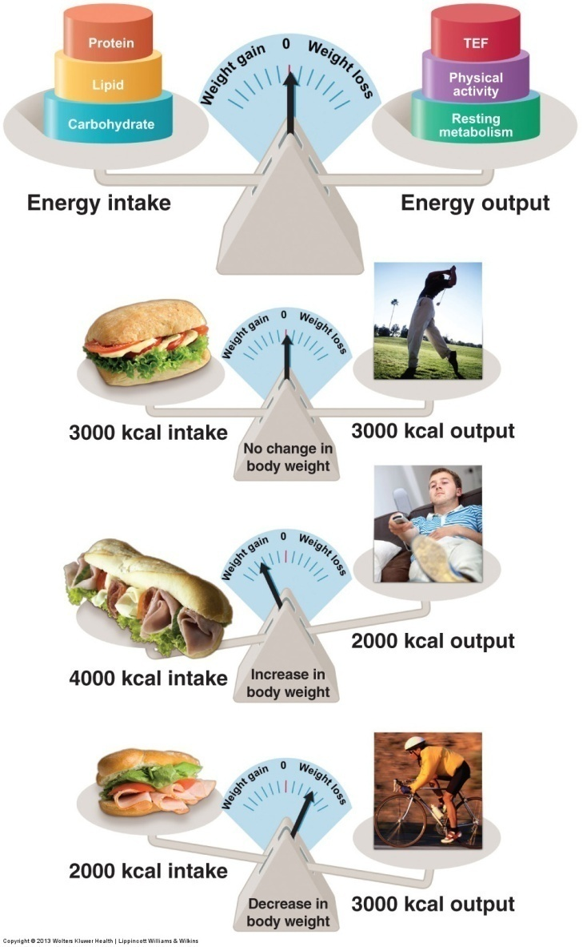

Slide 6
Principles of healthy eating
Variety and balance
Choose foods from a variety of sources
Balance in one’s diet indicates the intake of nutrients from the major foods groups
Moderation
Eating moderately requires appropriate planning to maintain balanced nutrient intake

Slide 7
MyPlate
www.choosemyplace.gov
Unveiled in 2011 by USDA helps put the dietary guidelines into action
Potential problems with my plate?
Doesn’t give much information about what foods are in each food group
No text or verbiage

Slide 8


Slide 9

https://health.gov/dietaryguidelines/2015/guidelines/

Slide 10
Mediterranean and vegetarian diet pyramids
Mediterranean diet
emphasizes fruits, nuts, vegetables, legumes, whole grains, and lean protein
High monounsaturated fatty acid content
Vegetarian diet
consists of foods from the plant kingdom

Slide 11
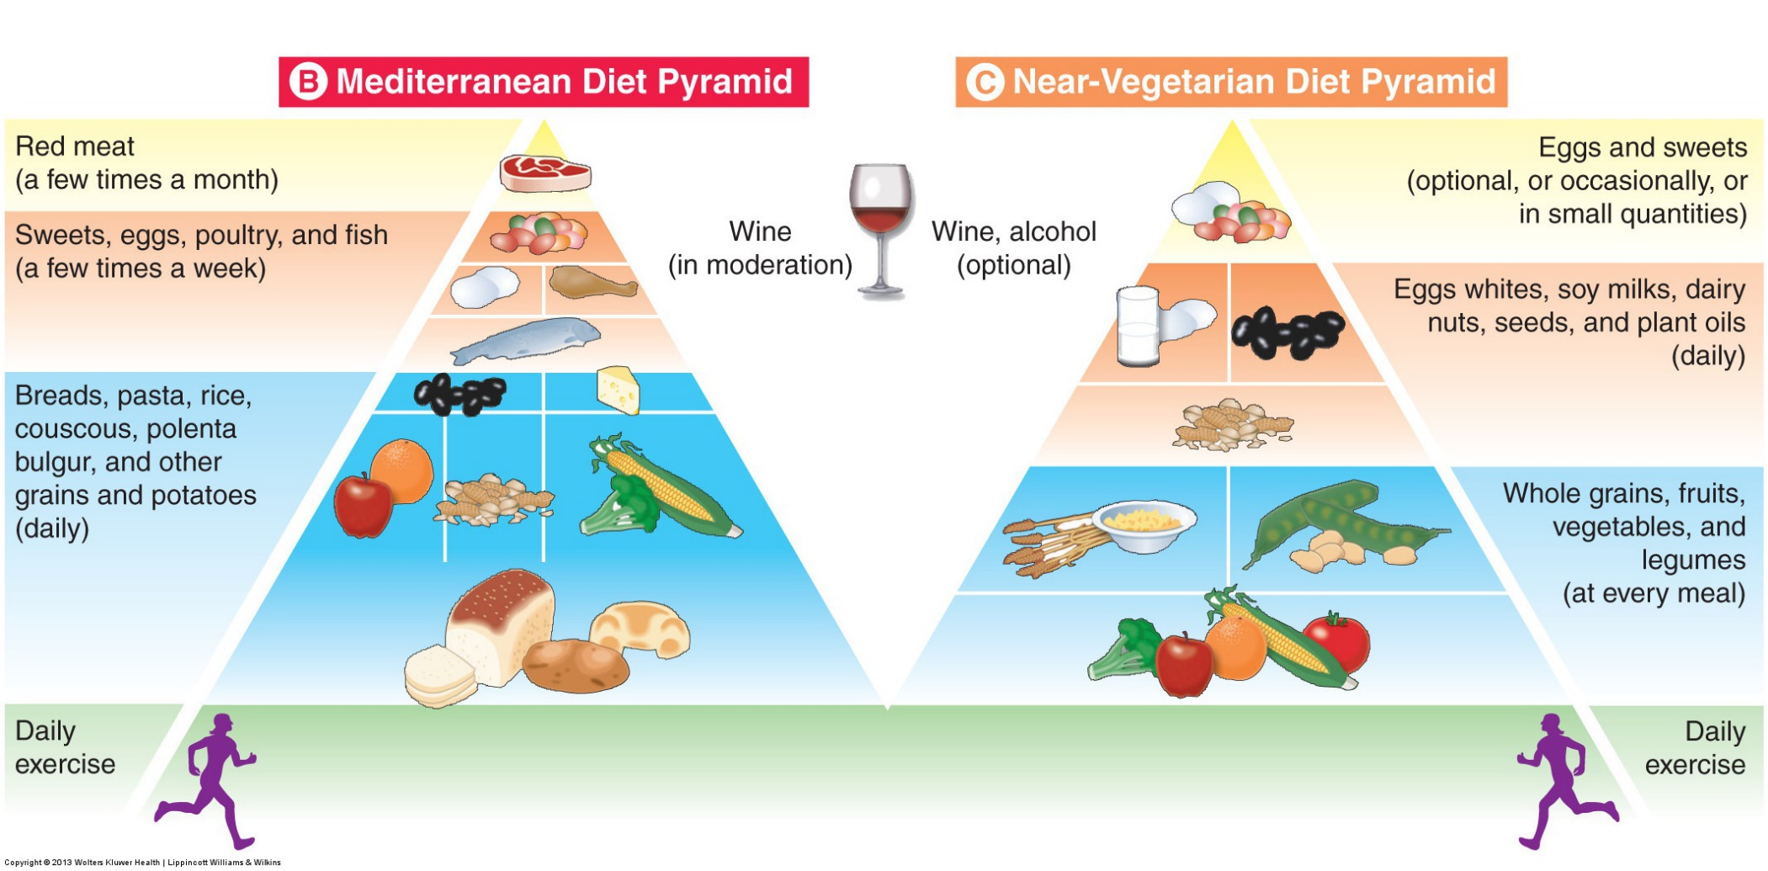

Slide 12
Diet quality index (DQI)
The DQI focuses on the nutritional elements of a diet
A simple scoring system based on the risk gradient associated with diet and the major diet related chronic diseases
A score of <= 4 reflects a more healthful diet
A score of >= 10 reflects a less healthful diet needing improvement

Slide 13
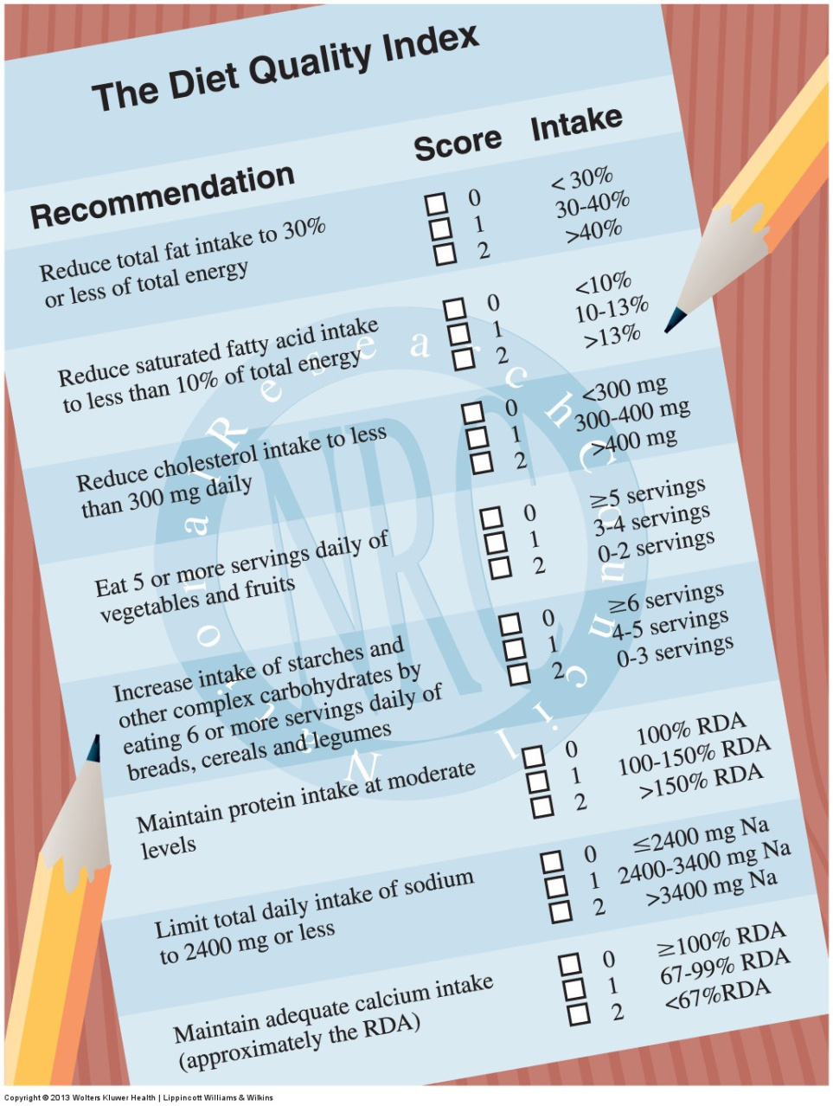

Slide 14
The healthy eating index (HEI)
Designed by the USDA for nutrition promotion activities and to monitor changes in diet quality over time
A poor diet = HEI score of 65
A good diet = HEI score > 85
HEI scores for each component of the index are defined as “poor” score, < 5 , needs improvement score 5-8 and good score > 8

Slide 15
Protein intake among the physically active
RDA for protein
Eating a high-carbohydrate diet with adequate energy intake conserves muscle protein
Endurance training
1.2 – 1.4 g/kg of body weight daily
Resistance training
up to 1.8 g/kg body weight daily

Slide 16
Simple amino acids
Some athletes supplement
Advocates believe the body absorbs the simple amino acid molecule more readily
The healthy intestine absorbs amino acids rapidly when they exist in more complex di – and tripeptide molecules, not just in simple amino acid form

Slide 17
Lipid intake among the physically active
To promote good health , lipid intake should probably not exceed 30%
Significant reductions in dietary lipid compromise endurance exercise performance
Lipids are necessary to obtain essential fatty acids and fat-soluble vitamins

Slide 18
Carbohydrate intake among the physically active
A low-carbohydrate diet rapidly compromises energy reserves
Physically active individuals should consume at least 55-60% of calories as carbohydrates
Endurance training = 10g carbohydrate per kg body mass per day

Slide 19
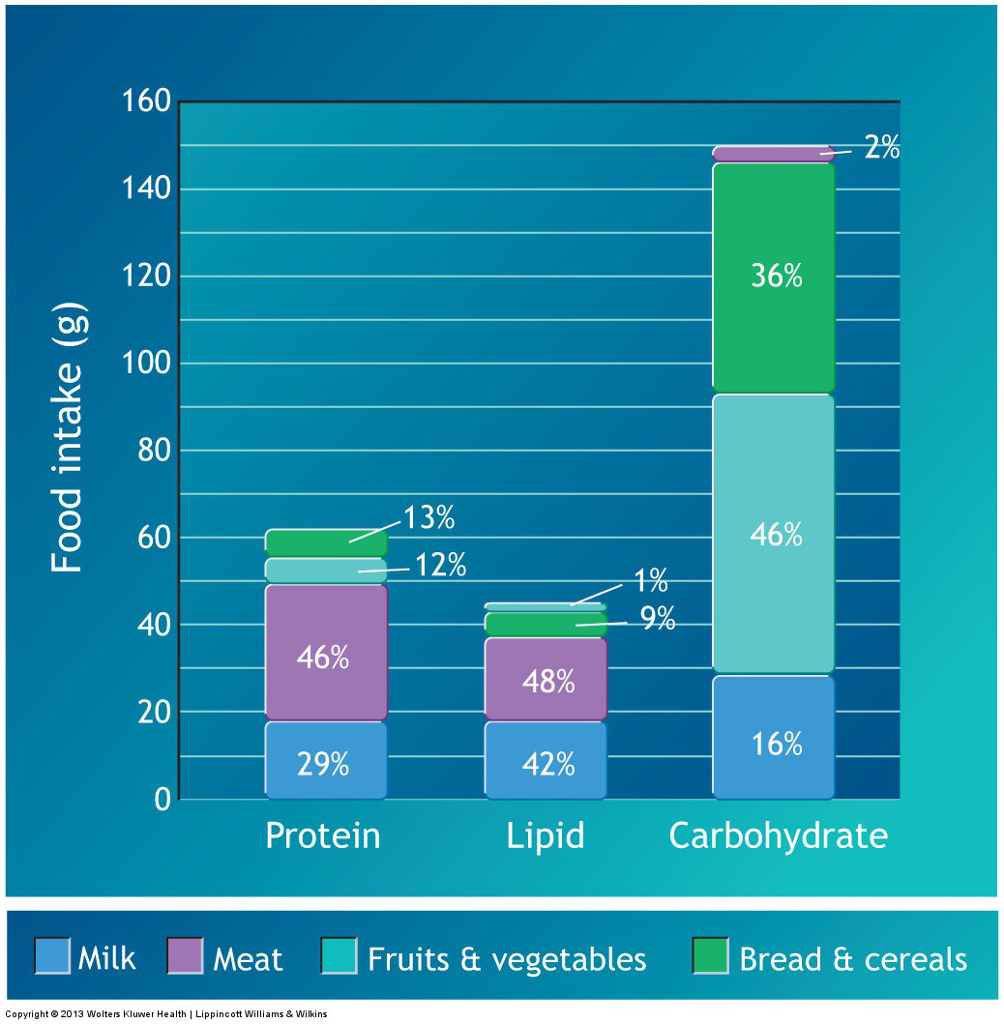

Slide 20
Vitamin-mineral deficiencies
Most often occur in :
vegetarians or groups with low energy intake
Those who eliminate >= 1 food groups from their diet
individuals who consume large amounts of processed foods and simple sugars

Slide 21
Antioxidants
Aerobic exercise metabolism increases the production of free radicals
Antioxidants
B- carotene
vitamin C
vitamin E
selenium, copper, manganese, and zinc coenzyme Q10

Slide 22
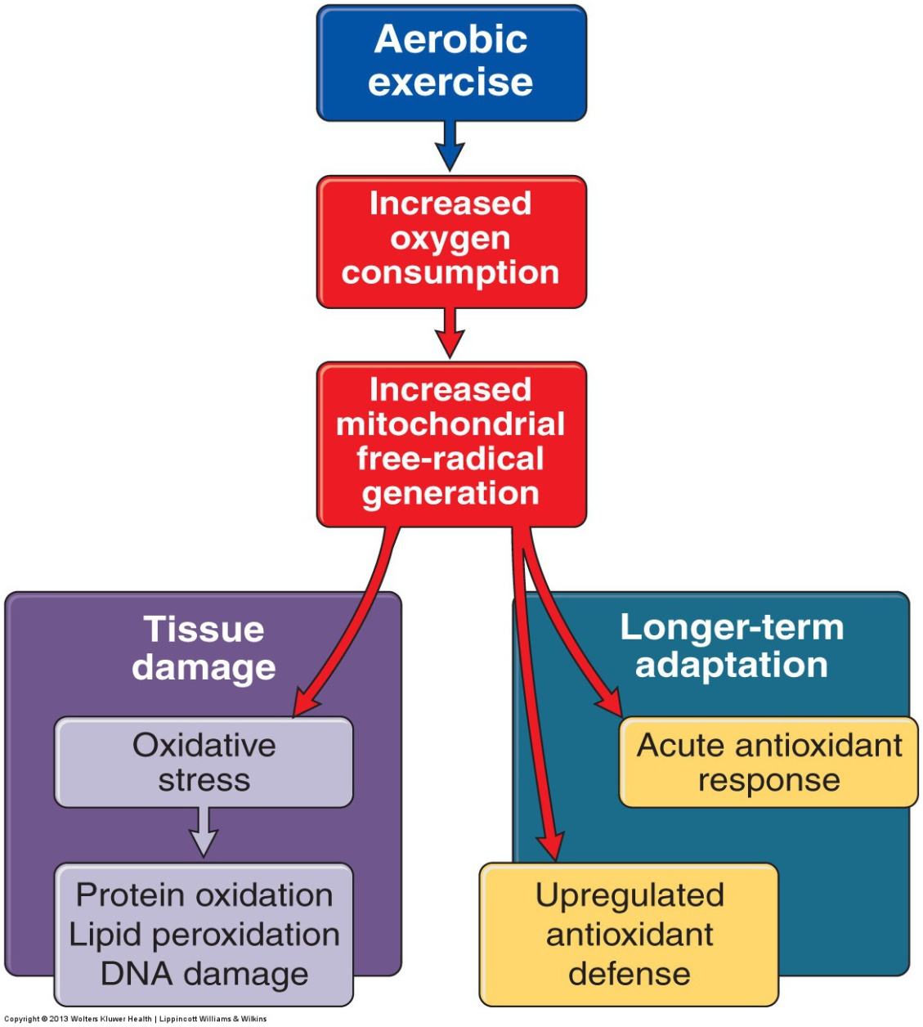

Slide 23
Exercise intensity and the immune system
Moderate Exercise
boosts natural immune functions and host defenses for up to several hours
Exhaustive exercise
a prolonged period severely impairs the body’s first line of defense against infection

Slide 24
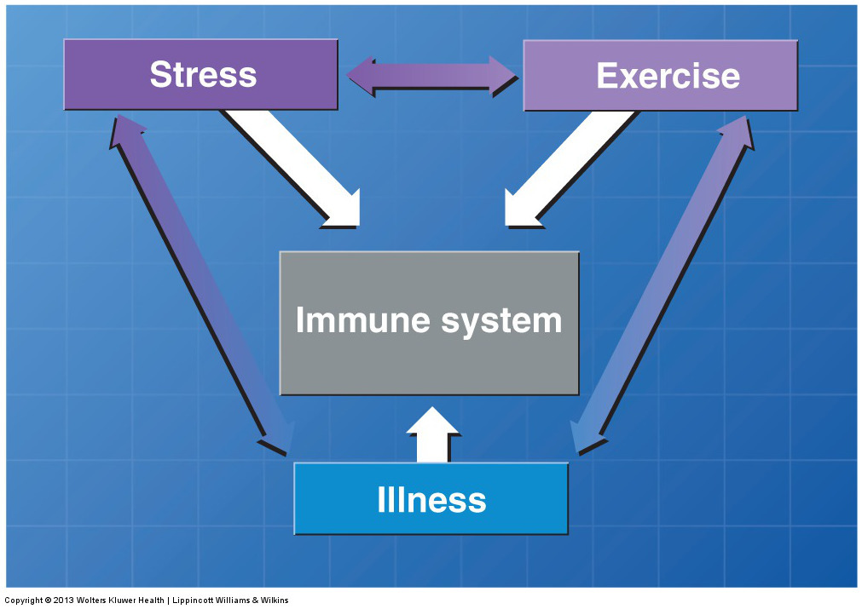

Slide 25
Minerals
Excessive sweating during exercise causes loss of body water and minerals
Mineral loss should be replaced after exercise through well-balanced meals
Single-minerals supplementation is not advised unless prescribed because of potential adverse consequences
Notes:
Short- and long-term mineral supplementation above recommended levels does not benefit exercise performance or enhance training responsiveness.

Slide 26
Trace minerals and exercise
Strenuous exercise may increase excretion of the following 4 trace elements:
chromium
copper
manganese
zinc

Slide 27
Exercise and food intake
Energy intake needs to be balanced with energy expenditure
Individuals who engage regularly in moderate to intense physical activity eventually increase daily energy intake to match their higher level energy expenditure
Women athletes usually do not meet energy intake recommendations

Slide 28
